Slide 1
We would like to understand spending patterns for each customer. Please help us understand what each customer spent during each month in 2004, 2005 and 2006

Slide 2
What is the average monthly spend by each customer for each month

Slide 3
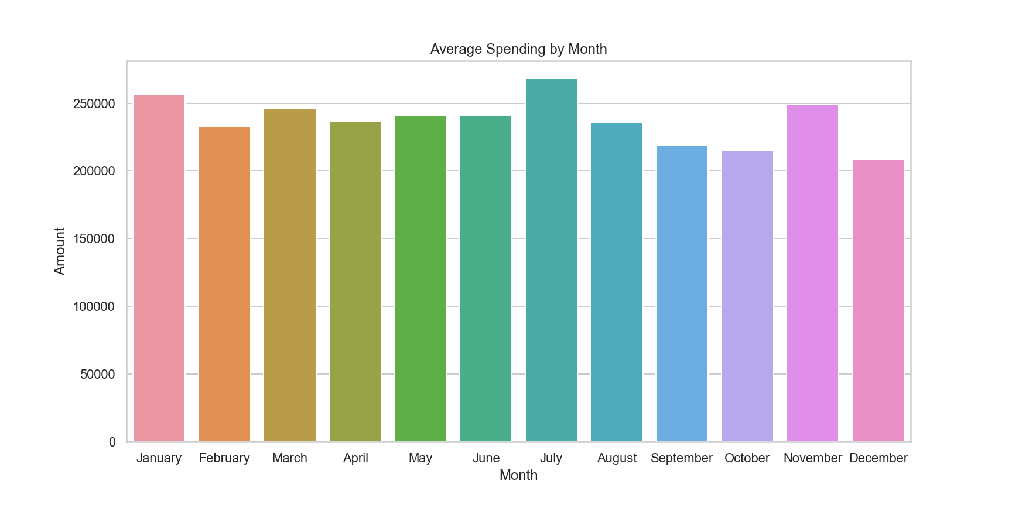
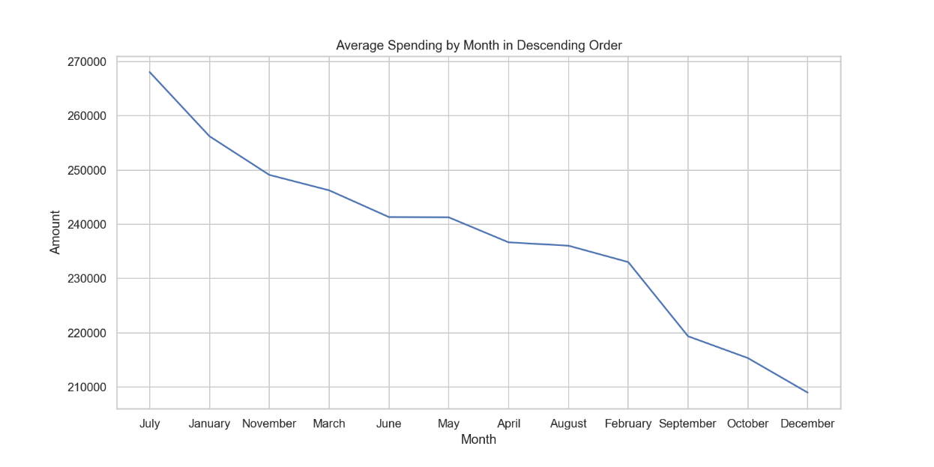
What are the top 3 months in terms of average spend by month?
The highest spending on average is recorded in the month of July. January and November take up the second and third spot respectively. September, October and December recorded the lowest spending on average.

Slide 4
Which 10 customers spend the most money in festive season months (November and December) and winter months (May, June and July). We need two dataframes.
festive season months
winter months
1 | A22
2 | A27
3 | A62
4 | A41
5 | A36
6 | A19
7 | A21
8 | A20
9 | A61
10 | A35
1 | A60
2 | A38
3 | A45
4 | A13
5 | A48
6 | A14
7 | A61
8 | A12
9 | A30
10 | A39

Slide 5
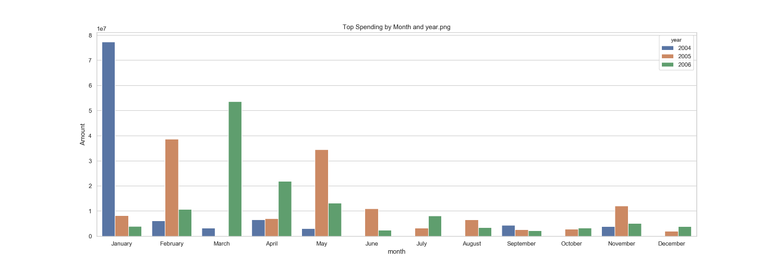
Which month do we record more customer spend in, does this differ by year?
The highest spending is recorded in January of 204 and it is more than twice the spending in 2005 and 2006 combined. February seen the highest spending in 2005 while March in 2006. March, June, July, August, October and December each have at least a year with no transaction recorded.

Slide 6
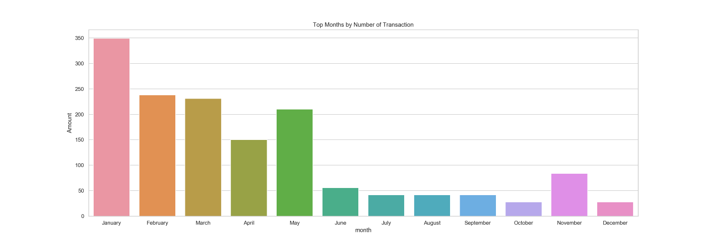
Which month do we record more customers spending money in terms of number of transactions?
The highest number of transactions is recorded in January. There has been a continuous decline in the number of transactions recorded with May and November the only months to have broken the trend. Nevertheless, there is a general decline in the number of transactions recorded over the months.

Slide 7
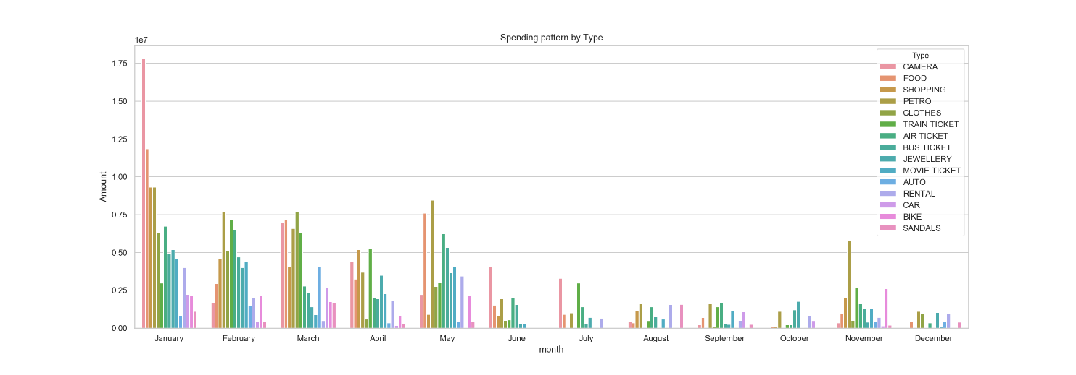
What are most customers spending money on, does this change by month?
Spending on CAMERA in January is the singular pattern with the highest spending. This is followed by FOOD in the same month. While months such as January, February, March, April and November have recorded at least a spending on each of the type available, the remaining months have at least one type with no spending recorded.

Slide 8
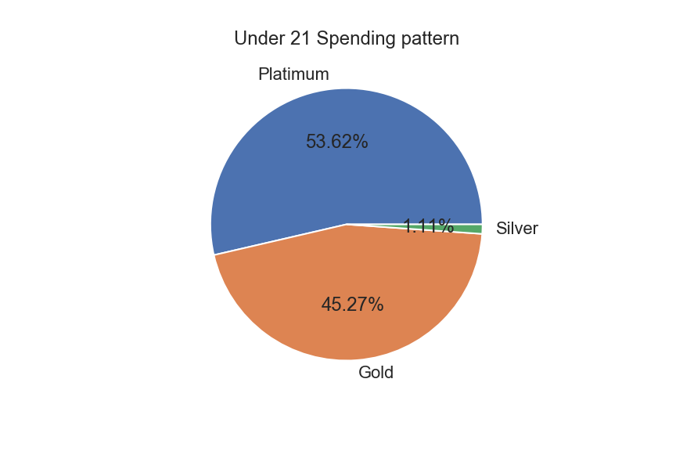
What products are users under the age of 21 spending more money on?
Platinum is the most purchased product among customers under the age of 21 with 53.62% of total spending. Platinum is followed by Gold containing 45.27% of total spending. Last on the list is Silver racking up only 1.11% of all spending.

Slide 9
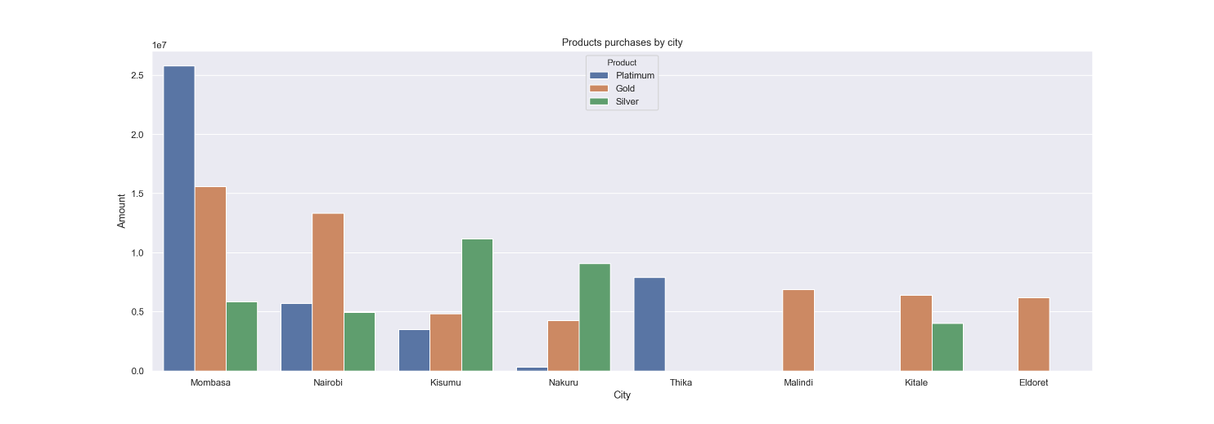
What products are users between the ages of 25 and 40, spending more money on, does this differ depending on the city they are from?
The city of Mombasa has the highest total transactions with platinum making up almost half of its total transactions. Nairobi, the second highest spending city spends about twice on Gold than it does on Platinum and Silver combined. Third highest spending city Kisimu spends has more than half of its total spending on Silver. Lowest spending city Eldoret spends only on Gold. Thika as well as Malindi also spend on only one product.

Slide 10
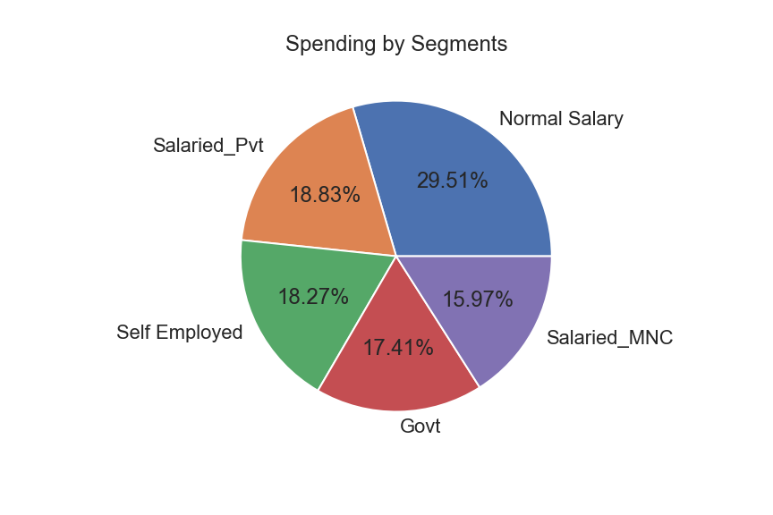
Which segment have recorded the highest spending?
Spending is almost evenly distributed amongst the various segments although customers on Normal Salary recorded the highest making up 29.51% of total spending. Customers on Salaried_Pvt, Self Employed and Govt constitute 18.83%, 18.27% and 17.41% respectively. Salaried_MNC are the lowest with 15.97% of all spending.

Slide 11
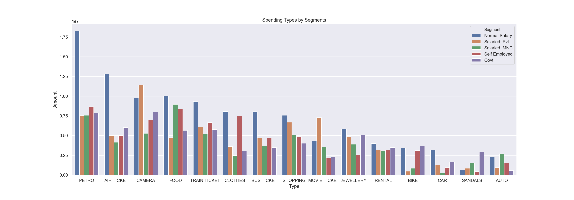
What do so customers in deferent segment spend money on?
Customers on Normal Salary spend more on nearly all types compared to customers on other segments. In general, customers spend more o petrol, with AIR TIICKET, CAMERA, FOOD and TRAIN TICKET rounding up the top five. CAR, SANDALS and AUTO make up the bottom three.

